Slide 1

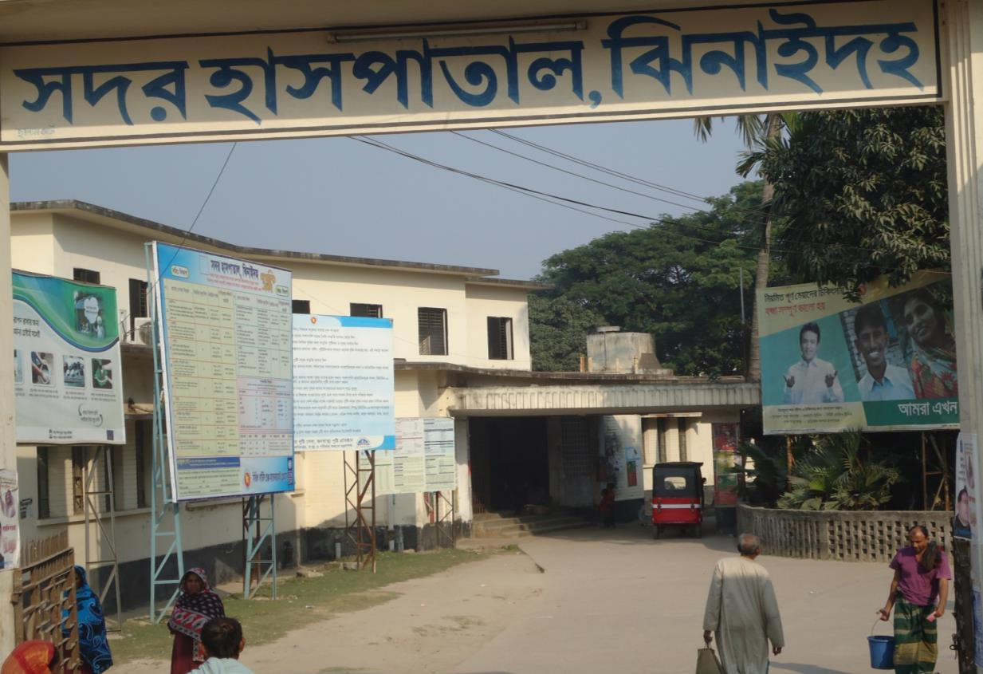
WELCOME TO
SADAR HOSPITAL, JHENAIDAH
Dr. Md. Emdadul Haque
Senior Consultant (Obs & Gyn)

Slide 2
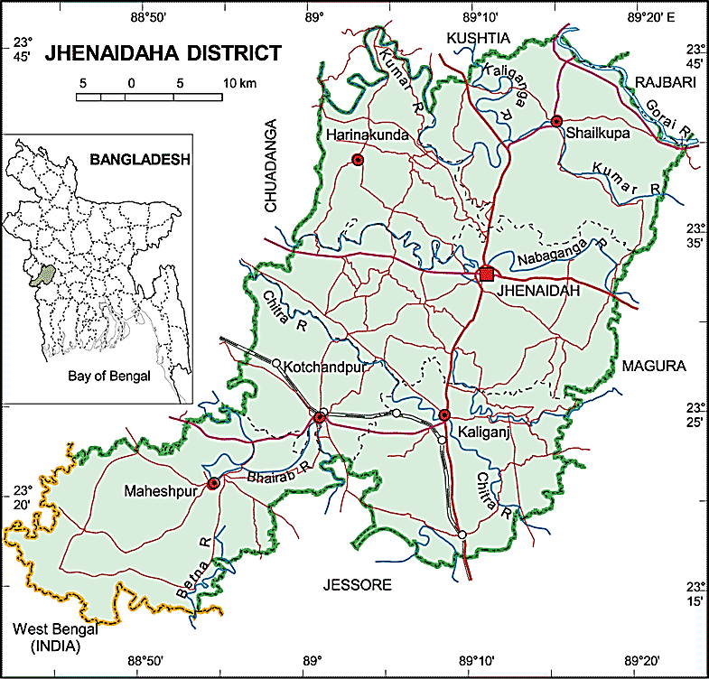

Slide 3
Comparative data of health facilities of different country of the world
SL NO | Country | Per capita health Expenditure per year by Govt ($) | Doctors per 10000 Population | Nurse per 10000 population
01 | USA | 4437 | 24 | 98
02 | UK | 2919 | 27 | 101
03 | Japan | 2644 | 21 | 41
04 | Malaysia | 356 | 9 | 33
05 | Sri Lanka | 66 | - | 19
06 | Indonesia | 55 | 3 | 20
07 | India | 39 | 6 | 10
08 | Pakistan | 23 | 8 | 6
09 | Nepal | 22 | 8 | 6
10 | Bangladesh | 19 | 3 | 3

Slide 4
MCH Profile of Jhenaidah District- 2013
Total population : 1857149
Total Pregnant : 38074
Total Live birth : 36465
Total Under five children : 222120
As per National data
Total Death : 11142 (D.R 6.1/1000 pop)
Total Maternal Death : 72 (MMR 194/100000 LB)
Total Parental Death : 1522 (PNDR 40/1000 Del)
Total Neonatal Death : 922 (NNDR 25/1000 LB)
Total Infant Death : 1218 (IMR 33/1000 LB)
Total Under five Death : 1698 (U5MR 46/1000 LB)
Total maternal morbidity : 2160 per year
Total morbidity increasing : 4375 per year
Total low birth wait : 8386 (23% of total birth)

Slide 5
Background History of Jhenaidah Sadar Hospital
Jhenaidah Sadar Hospital was established in 1968 as Sub-Division Hospital and became functioning from December 1970.
- From February 1984 recognized as District Sadar Hospital.
- In 1994 upgrade to 100 Bedded Hospital without manpower & infrastructure.
- In May 2005 infrastructure of 100 beded hospital completed.
- In 2008, Laparoscopic surgery was initiated in Hospital.
- In 2010 , this Hospital was awarded for EOC Activities, in Khulna Division.
- TQM activities started in January 2011 and effectively in May 2012.
In 10’th October foundation stone for 250 bedded hospital is established by Honorable Prime Minister of Peoples Republic of Bangladesh.
- In 9 Feb, 2014, 5S KIZEN – TQM program started by DGHS & SMPP JICA.

Slide 6
A District level Patient-Friendly Hospital with a Vision …
Maximum utilization of Govt.
resources with honesty and sincerity
Integrated approach of
Administration, Community
Leaders & Health Management
Providing Effective and
prompt services through improved
management system
Develop as a model District
Hospital in Bangladesh

Slide 7
Jhenidah Sadar Hospital, Jhenidah
Kaizen Works Summary
Before Kaizen Situation
1. Inadequate Documentation and Reporting System
2. Inadequate EOC Services
3. Inadequate Overall Cleanliness
4. Less Community Participation
5. No initiative of Local Resource Mobilization for Hospital Improvements
After Kaizen Situation
1. Improved Documentation and Reporting System
2. Improved EOC Services
3. Improved Overall Cleanliness
4. Significant Community Participation
5. Effective Local Resources Mobilization for Hospital Improvements

Slide 8
Human resources of Jhenaidah Sadar Hospital-2013
(100 Beded ( 50 Beded )
Post Post Vacant
a) Doctors 42 22 2
Super 01 0 0
Consultant (11+10) 21 10 2
MO 20 12 0
b) Nurse 38 42 2
Super 01 0 0
Supervisor 02 02 0
SSN/ JN (35+0) 35 (35+5) 40 2
c) 2nd & 3rd Class 30 20 3
Office Staff 08 04 0
MT +Pharma (6+3) 09 (3+3) 06 1
Others 13 10 0
d) 4th Class 40 24 0
Aya+Ward Boy (3+5) 08 0 0
MLSS+ Cleaner (5+8) 13 (10+7) 17 0
Guard 05 0 0
Cook 04 03 0
Others 14 04 0
Total Manpower 150 105 5
e) Non Govt Aya+ Cleaner+ Guard 38 0

Slide 9
Sadar Hospital, Jhenidah
Emergency, Out door & Indoor Service 1998 to 2013
Sl No | Year | Emergency Patients | Out door Service | indoor Service | Bed occupancy rate
01 | 1998 | 16733 | 65062 | 12973 | 126%
02 | 2011 | 28855 | 141999 | 22435 | 146%
03 | 2012 | 30001 | 141069 | 22951 | 143%
04 | 2013 | 30281 | 162510 | 24643 | 165%

Slide 10
Sadar Hospital, Jhenidah
EOC Service 1998 to 2013
Sl No | Year | ANC Services | Admitted Patient | Complications | Type of Delivery |  |  |  | PNC | Maternal Death
 |  |  |  |  | NVD | ASST DEL | CS | Total
01 | 1998 | 257 | 1364 | 542 | 951 | - | 155 | 1106 | - | 18
02 | 2011 | 1354 | 3906 | 1191 | 1912 | 33 | 430 | 2375 | 2140 | 1
03 | 2012 | 2268 | 4261 | 1934 | 1784 | 44 | 551 | 2379 | 2467 | 3
04 | 2013 | 7096 | 5445 | 3153 | 1783 | 28 | 985 | 2796 | 3606 | 3

Slide 11
Sadar Hospital, Jhenidah
Operation Service 1998 to 2013
Sl. No. | Year | Major | Minor | Total
01 | 1998 | - | - | 1089
02 | 2011 | 780 | 4857 | 5629
03 | 2012 | 977 | 5433 | 6410
04 | 2013 | 1294 | 4923 | 6217

Slide 12
Sadar Hospital, Jhenidah
Comparative Data of EOC service of 3 best performing District Hospital of Khulna Division in 2013
Sl No | Year | ANC Services | Admitted Patient | Type of Delivery |  |  |  | PNC
 |  |  |  | NVD | ASST DEL | CS | Total
01 | 250 bed Hospital, Jessore | 11454 | 4929 | 1163 | 30 | 1646 | 2839 | 1077
02 | 100 bad Jhenidah Sador Hospital | 7096 | 5445 | 1783 | 28 | 985 | 2796 | 3606
03 | 250 bed Hospital, Khustia | 4618 | 6522 | 1613 | 2 | 1023 | 2631 | 2634

Slide 13
Sadar Hospital, Jhenidah
Development in EOC Service in Jhenidah.
Introduce Labour Admission Register, Labour Ward Admission Form, Separate Discharge Form.
All EOC Related Patient kept in a ward.
Starting of ANC & PNC corner and Arrange a Room for Medical Officer.
NO. of EOC Bed increase from 10 to 21 though on EOC bed only 5.
Improve EOC Operation Theater.
Shifting of Labour room & arrange pre-labour room with three beds & maintenance of privacy.
Moral based environment with 7 (seven) workers supported by community donors.
Make a breast feeding corner & Provision of Vitamin A distribution for PNC Mother.
Starting of Health education system.
Set up of dropler machine & Ventouse Machince.
EOC Operation activities extended from 8 A.M. to 2 P.M to 8 P.M.
Ensuring Rational use of drugs in EOC ward.
Provision of Mobile Phone in EOC ward no. 01742732116.
Improvement of Eclumpsia room.
Provision of Emergency kit boxes such as PPH kit, Eclumpsia kit.
Shoe-free environment for infection control.
The center is used as a effective training center for SBA, Nursing student, Mid-wifiry.

Slide 14
Sadar Hospital, Jhenidah
Community Support System in Sadar Hospital
28 manpower (Cleaner 15, Aya 3, Guard 5, Volunteer 5 ) get 2000 Tk per month per month per person. is supported by the community. Among them, 11 manpower were supported by doctors.
Mayor of Jhenidah Paurshava plays a major role in cleanness of the outer environment of the Hospital and repaired the boundary wall and made 4 dustbins with a cost of nearly one lac taka, and support 3 man power.
Chairman of Zahedee foundation donates 10 manpower support and an intercom system with a cost of nearly two lac taka.
Mr. Anisur Rahman (Khoka) (Previous chairman, Jhenaidah Paurshava) donates one man power support and also support for shoe free environment.
UP Chairman, Harishonkorpur, Jhenidah repairs 3 benches for seating of EOC outdoor patient.
Some of the Pharmaceuticals help in forms and discharge certificate and seating arrangement

Slide 15
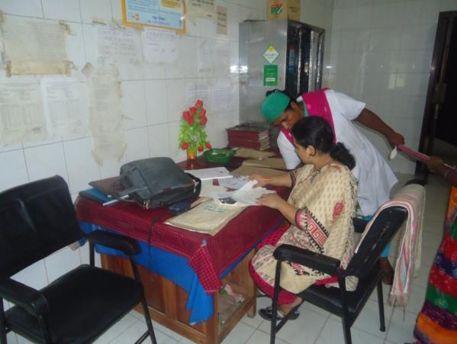
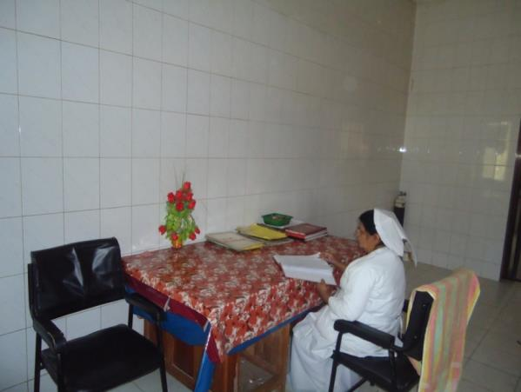
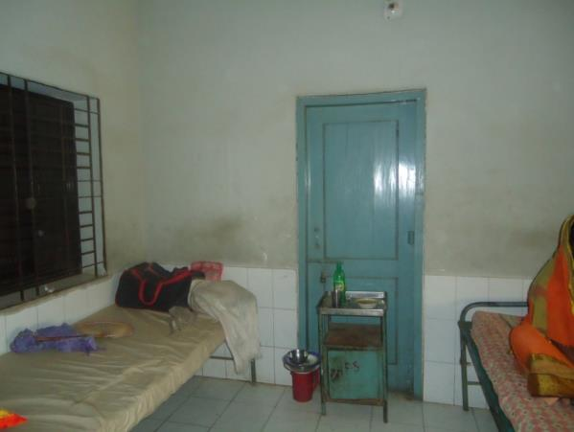
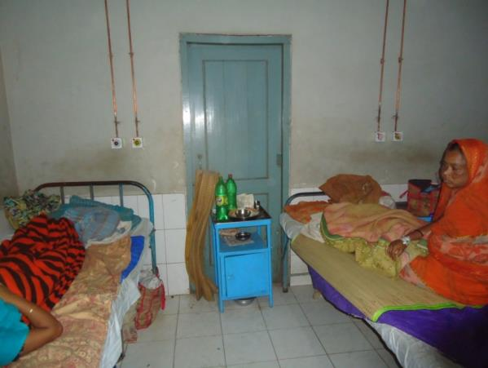
Before & After Situation
Before
After
Before
After

Slide 16
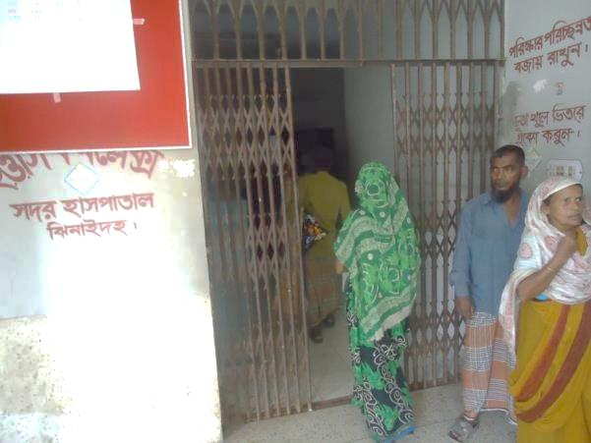
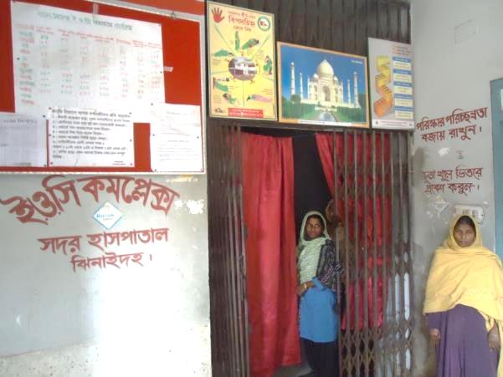
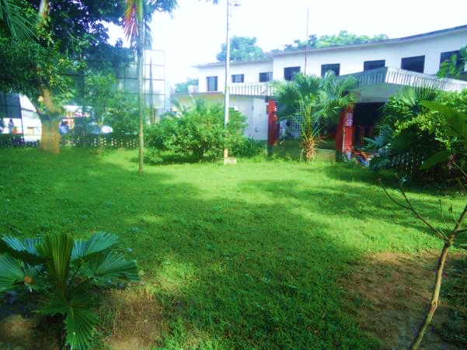
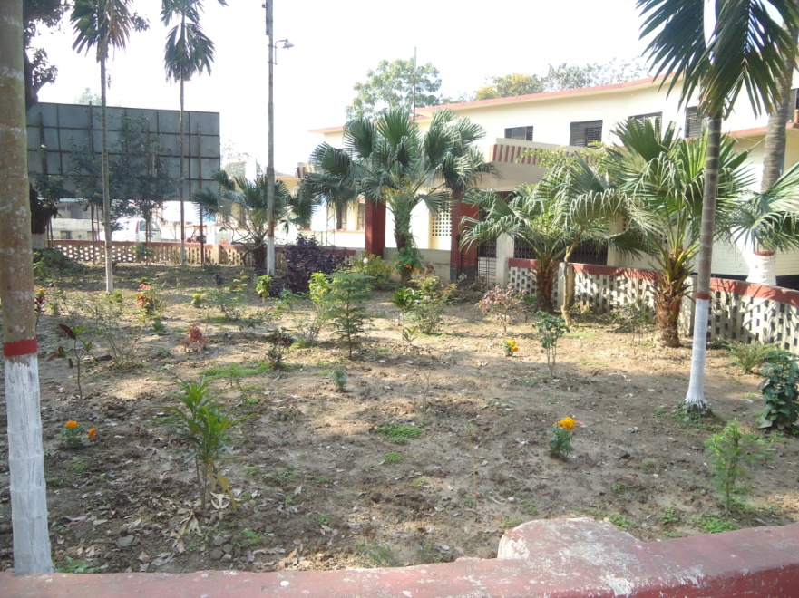
Before & After Situation
Before
After
Before
After

Slide 17
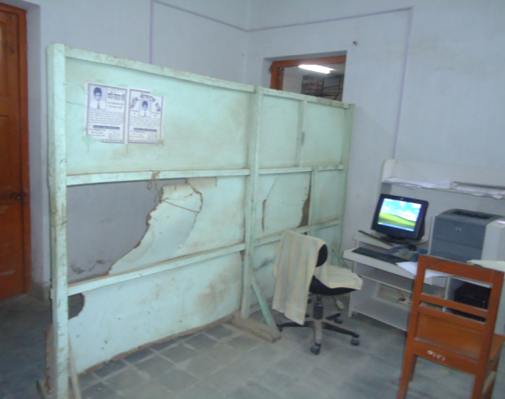
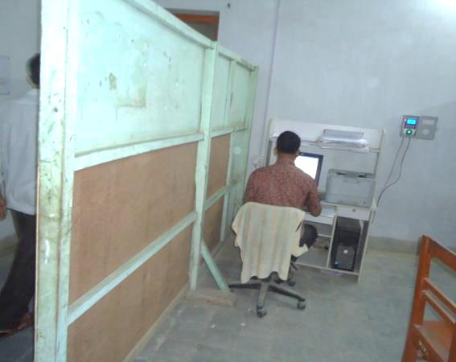
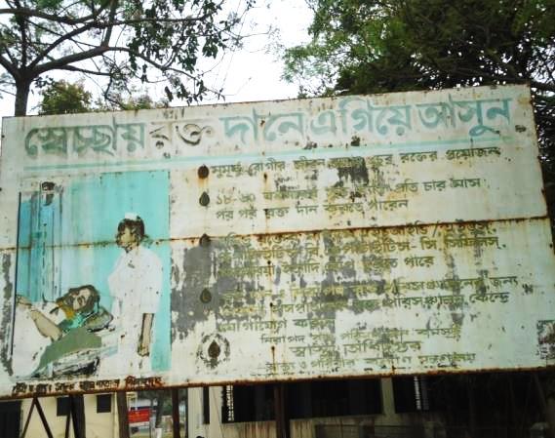
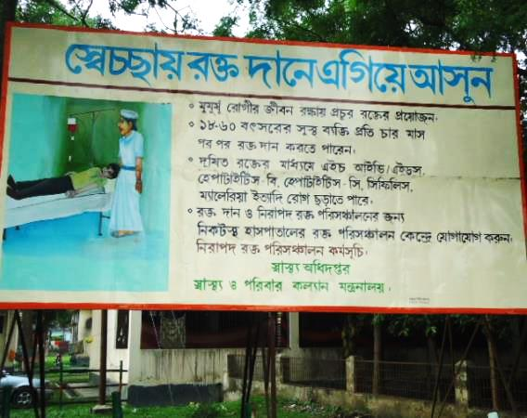
Before & After Situation
Before
After
Before
After

Slide 18
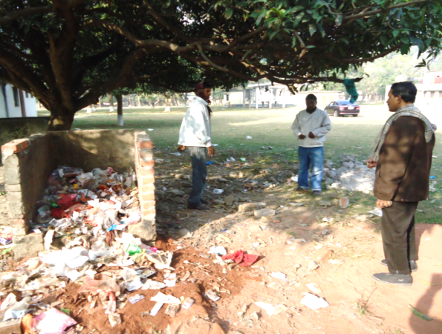
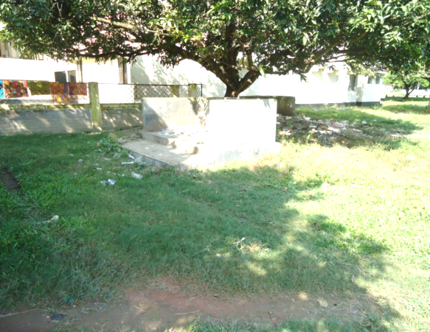
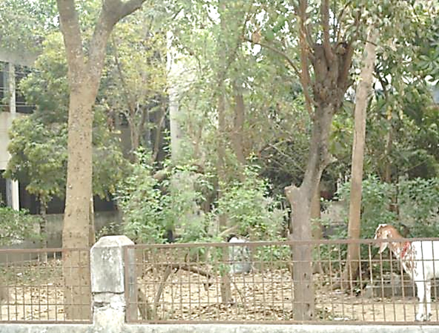
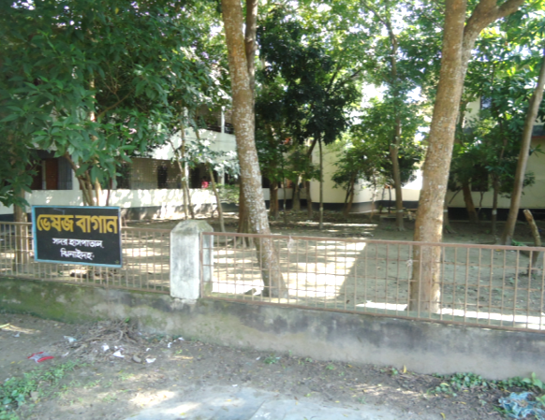
Before & After Situation
Before
After
Before
After

Slide 19
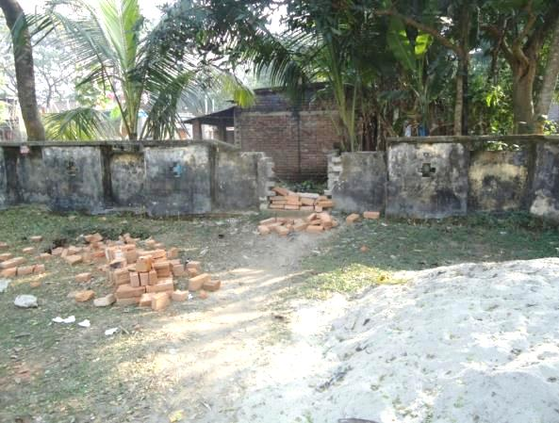
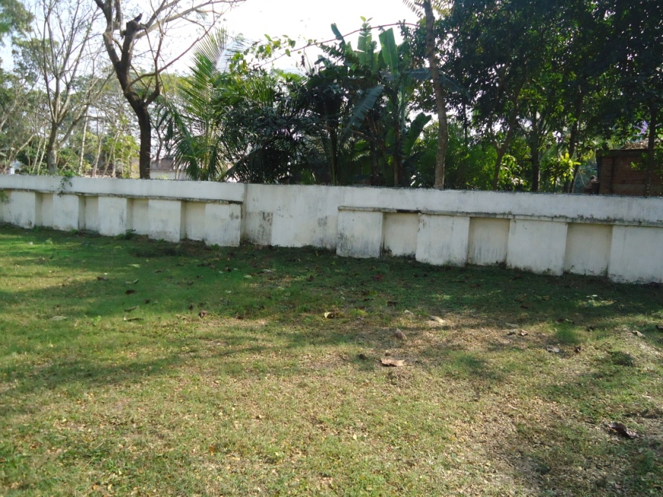
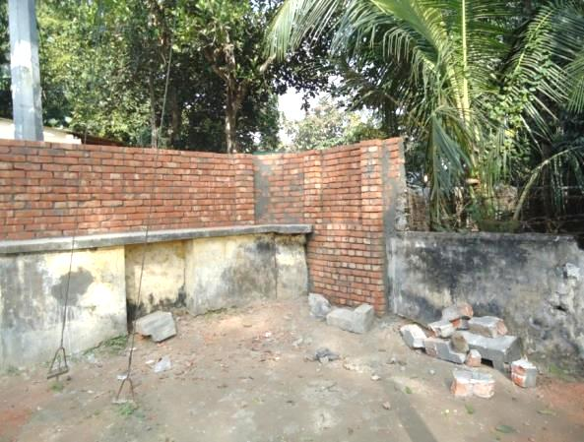
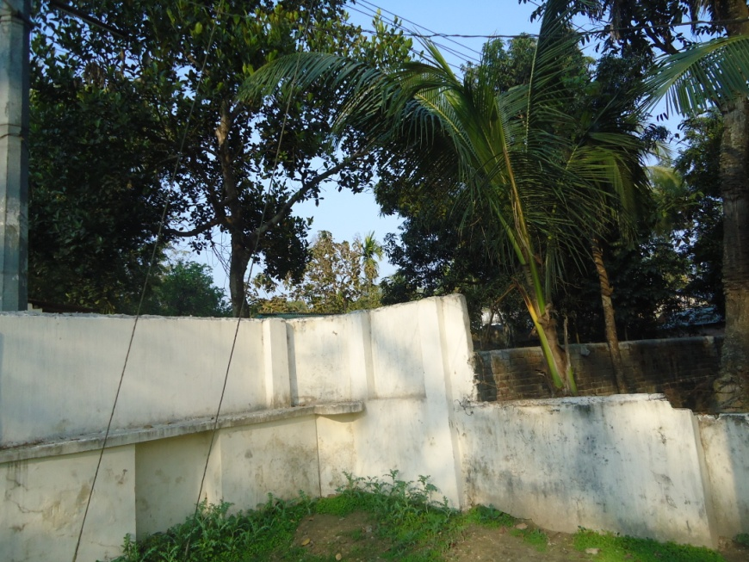
Local Govt. (Paurashava) Participation
Before
After
Before
After

Slide 20
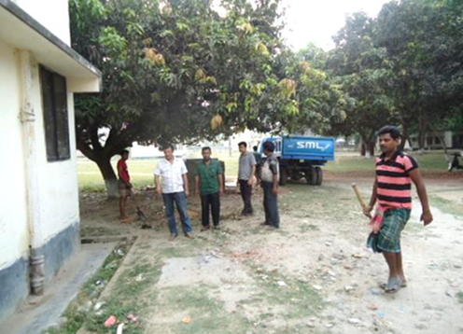
Local Govt. (Paurashava) Participation

Slide 21
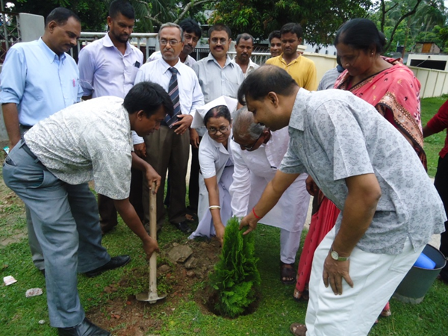
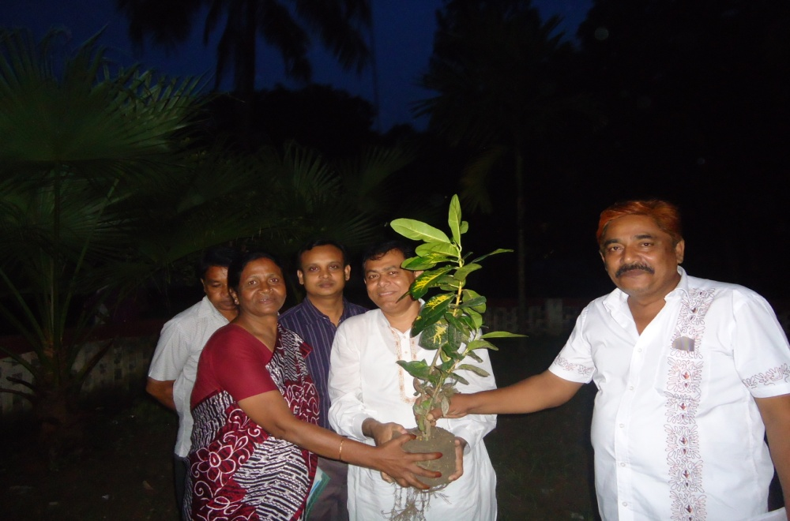
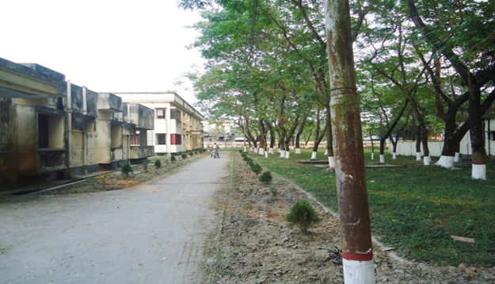
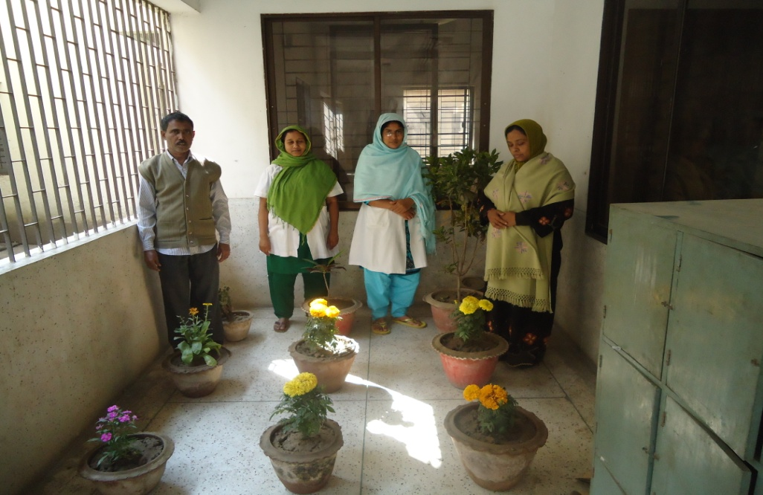
Beautification of the campus

Slide 22
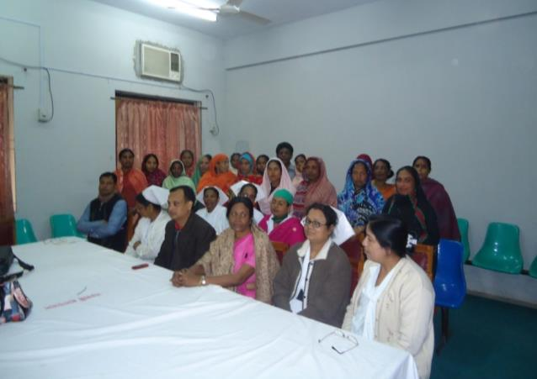
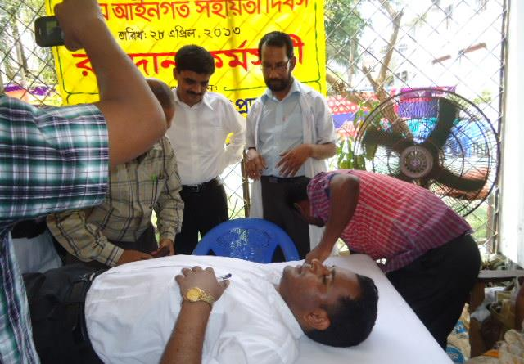
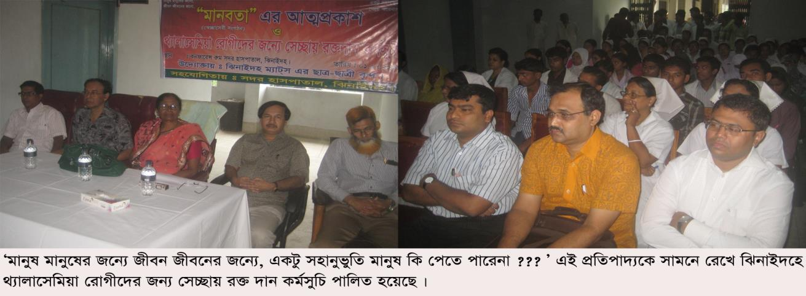
Blood Donation Program by Community

Slide 23
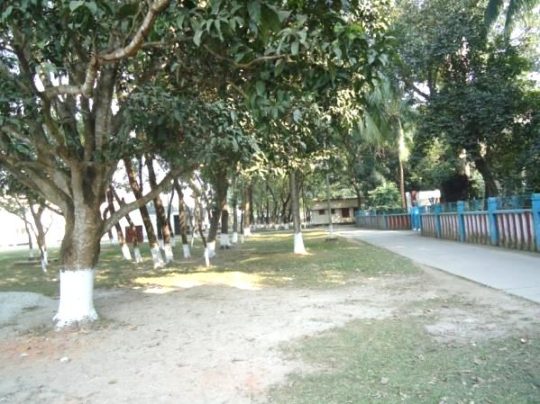
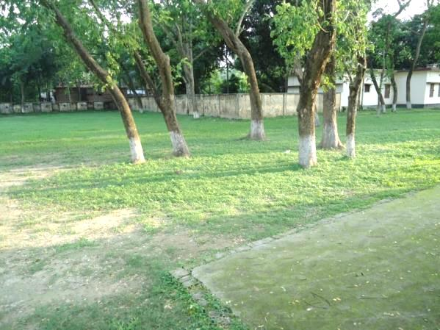
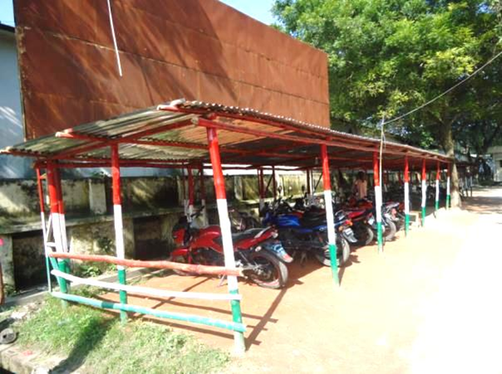
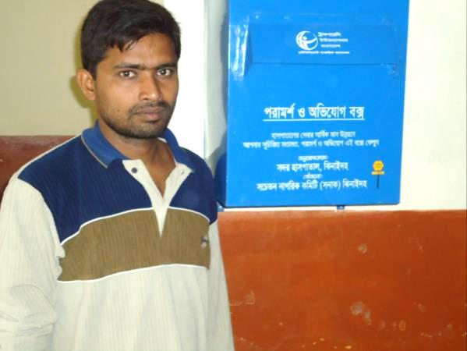
Present Environment of Hospital Campus
Complain &
Suggestion Box

Slide 24
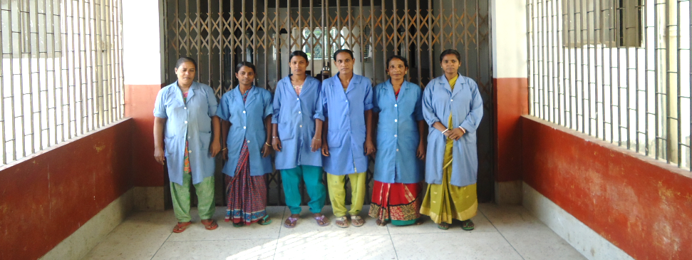
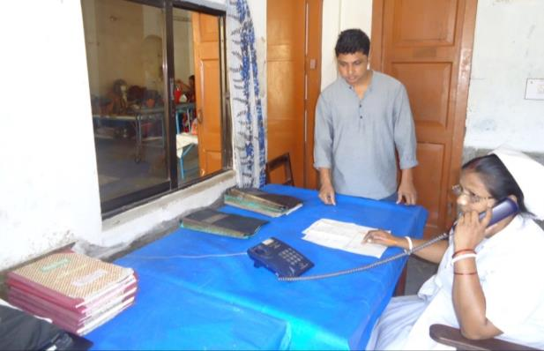
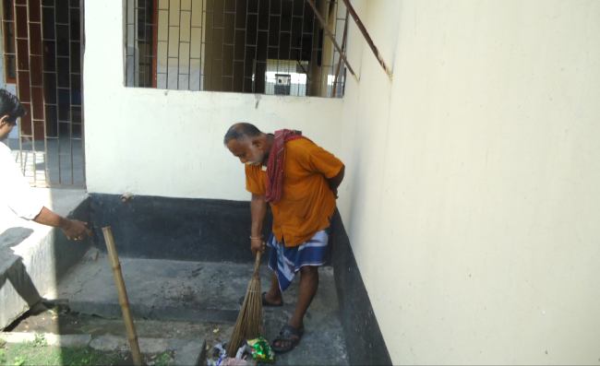
Community Donated Manpower & Logistics

Slide 25

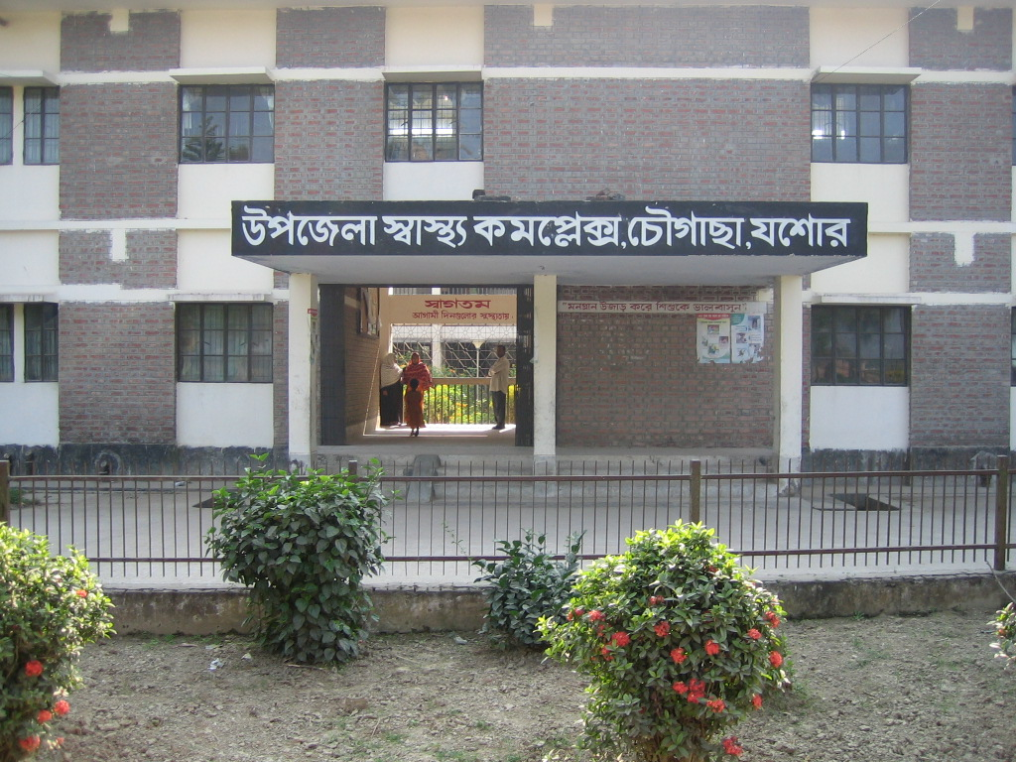
50 BEDED UPAZILA HEALTH COMPLEX
Chowgacha, Jessore.

Slide 26
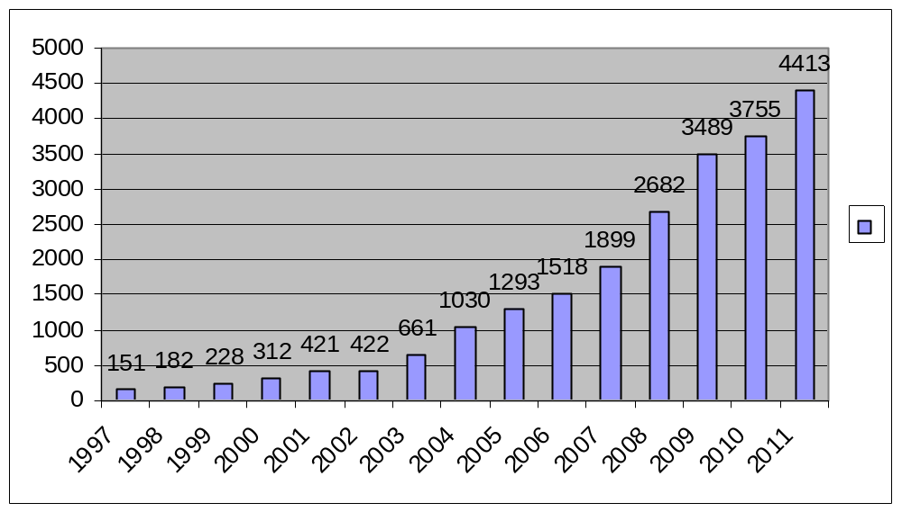
Upazila Health Complex
CHOWGACHA , JESSORE.
EOC Activities : 1997- 2011 (Hospital Delivery )

Slide 27
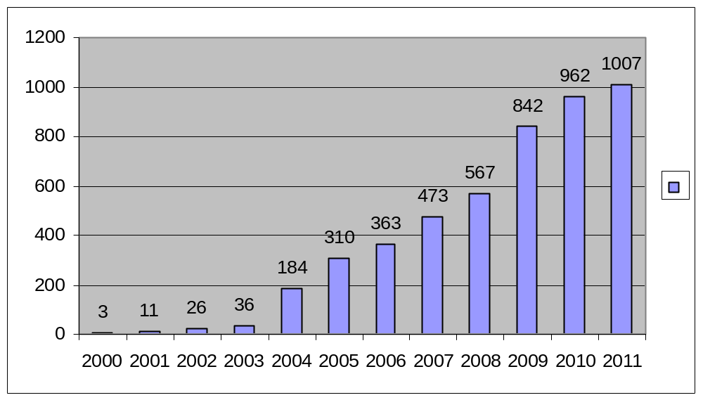
Upazila Health Complex
CHOWGACHA , JESSORE.
EOC Activities : 2000 - 2011 (Caesarian Section)

Slide 28
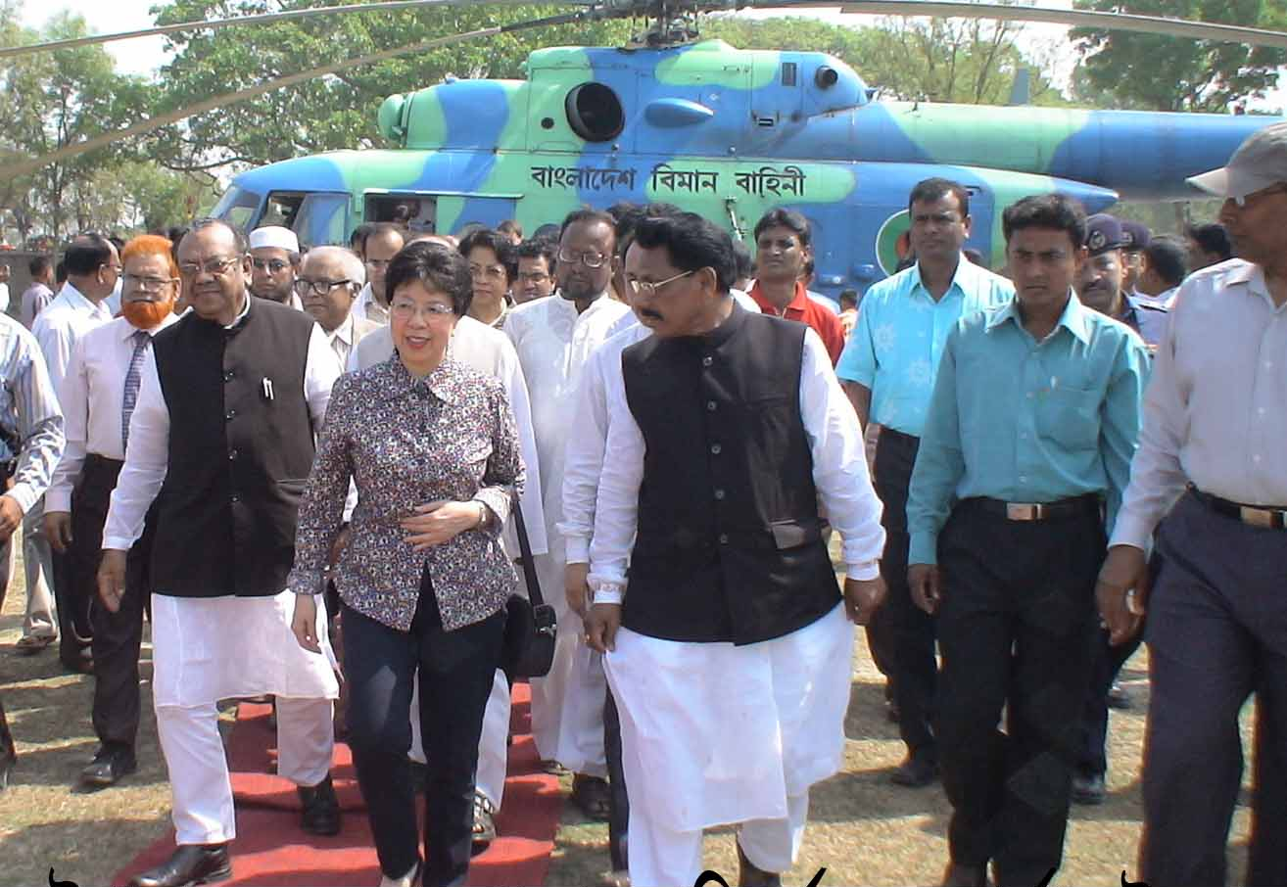
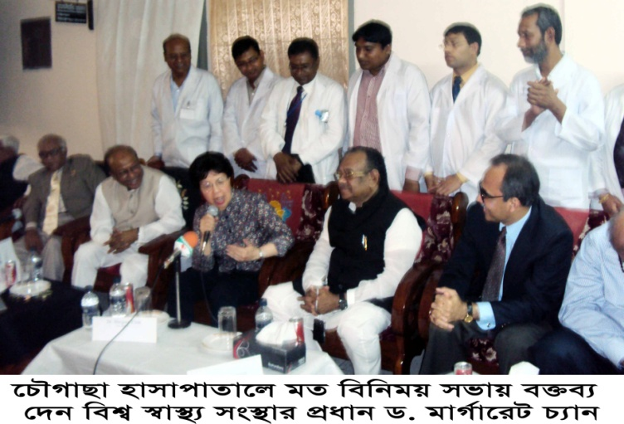

Slide 29

Thank you

Slide 30
Sadar Hospital, Jhenidah
EOC Service 1998 to 2013
Sl No | Year | ANC Services | Admitted Patient | Complications | Type of Delivery |  |  |  | PNC | Maternal Death
 |  |  |  |  | NVD | ASST DEL | CS | Total
01 | 1998 | 257 | 1364 | 542 | 951 | - | 155 | 1106 | - | 18
02 | 2009 | 434 | 3264 | 1374 | 1673 | 42 | 539 | 2254 | 2302 | 05
03 | 2010 | 1099 | 3514 | 1317 | 1778 | 32 | 546 | 2356 | 2256 | 4
04 | 2011 | 1354 | 3906 | 1191 | 1912 | 33 | 430 | 2375 | 2140 | 1
05 | 2012 | 2268 | 4261 | 1934 | 1784 | 44 | 551 | 2379 | 2467 | 3
06 | 2013 | 7096 | 5445 | 3153 | 1783 | 28 | 985 | 2796 | 3606 | 3

Slide 31
Sadar Hospital, Jhenidah
Comparative Data of Delivery of best performing EOC center of Khulna Division in 2013
Sl No | Year | ANC Services | Admitted Patient | Type of Delivery |  |  |  | PNC
 |  |  |  | NVD | ASST DEL | CS | Total
01 | Ad-din Hospital Jessore. | 27139 | 5146 | 944 | 0 | 2506 | 3450 | 3805
02 | Chowgacha UHC | 19249 | 4997 | 2333 | 13 | 900 | 3246 | 4835
03 | 250 bed Hospital, Jessore | 11454 | 4929 | 1163 | 30 | 1646 | 2839 | 1077
04 | 100 bad Jhenidah Sador Hospital | 7096 | 5445 | 1783 | 28 | 985 | 2796 | 3606
05 | 250 bed Hospital, Khustia | 4618 | 6522 | 1613 | 2 | 1023 | 2631 | 2634
06 | Fatima Hospital, Jessore | 17697 | 1451 | 356 | 0 | 1113 | 1469 | 555

Slide 32
Comparative data of health facilities of different country of the world
SL NO | Country | Per capita health Expenditure per year ($) | Doctors per 10000 Population | Nurse per 10000 population | Hospital bed per 10000 population
01 | USA | 4437 | 24 | 98 | 30
02 | UK | 2919 | 27 | 101 | 30
03 | Japan | 2644 | 21 | 41 | 137
04 | Saudi Arabia | 608 | 9 | 21 | 22
05 | Malaysia | 356 | 9 | 33 | 18
06 | Sri Lanka | 66 | - | 19 | -
07 | Indonesia | 55 | 3 | 20 | 6
08 | India | 39 | 6 | 10 | -
09 | Pakistan | 23 | 8 | 6 | 6
10 | Bangladesh | 19 | 3 | 3 | 6
11 | Nepal | 22 | 8 | 6 | -

